Slide 1
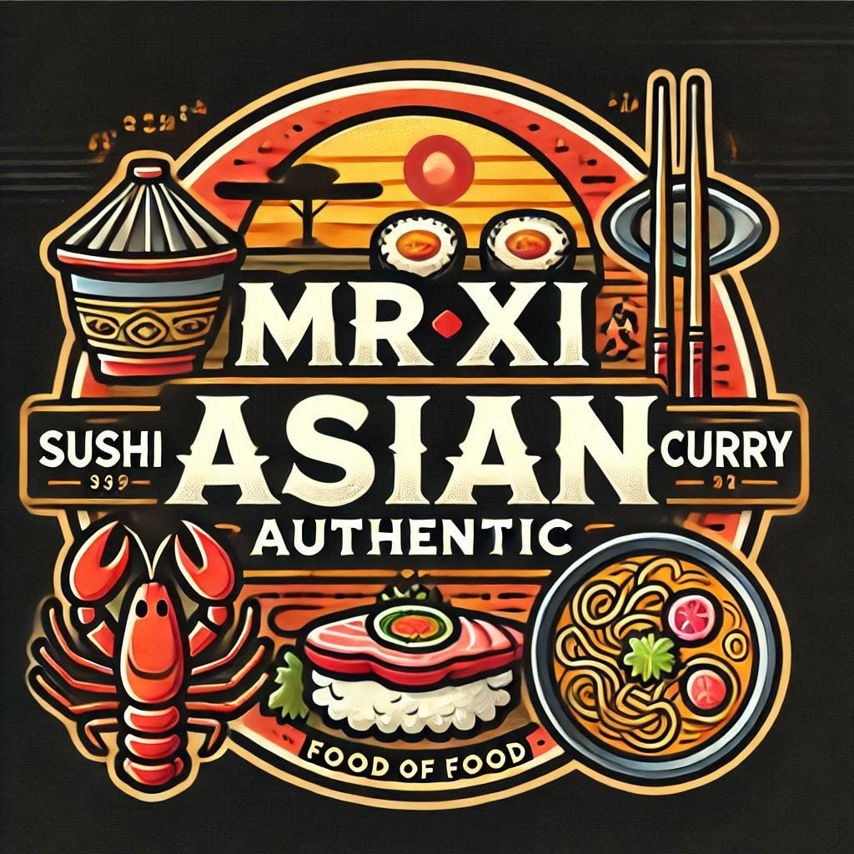
Restaurant Business Case Study
Mr. Xi Asian Authentic food
Ramen Sushi Curry

Slide 2
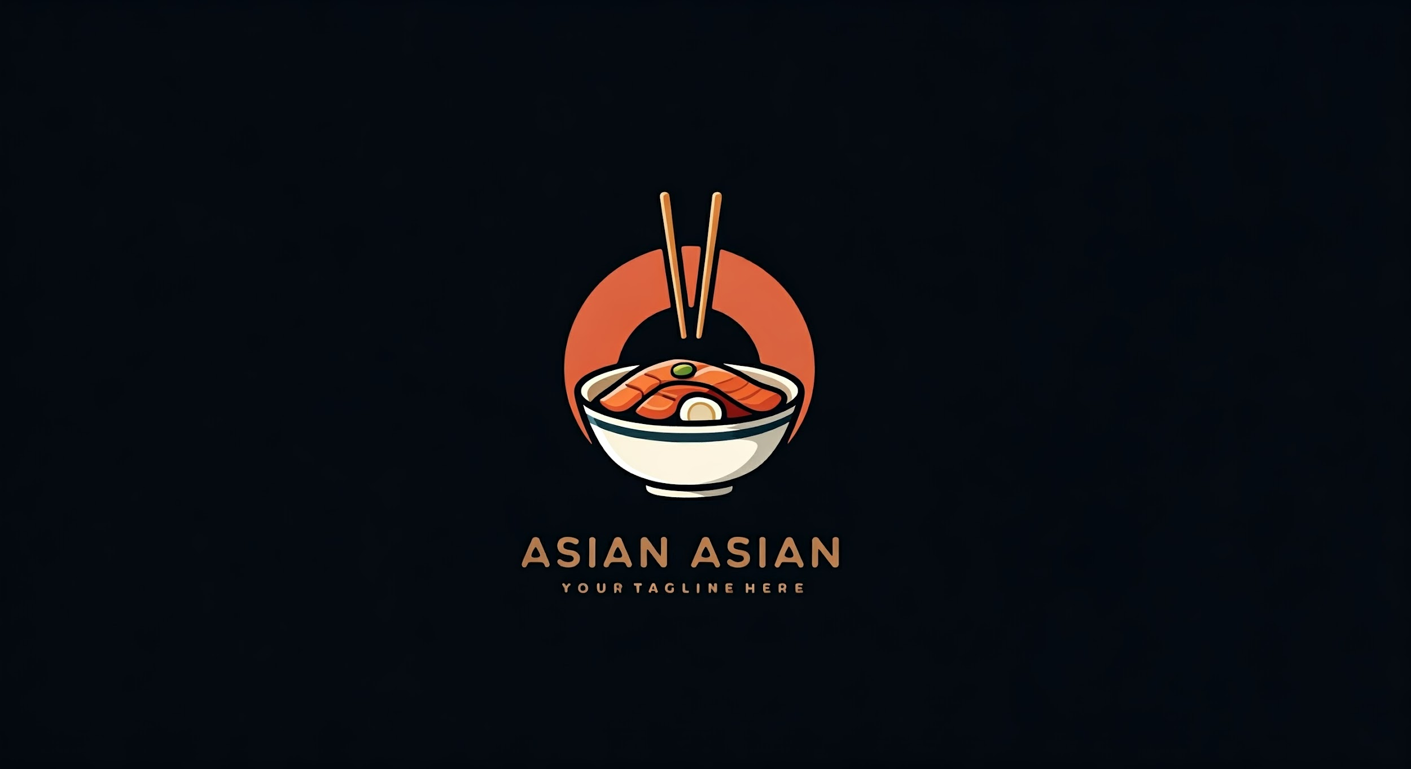

INTRODUCTION
This case study is to analyze the performance of Mr. Xi restaurant and its Loyalty Program for regular customers. I have set up a MySQL Workbench database schema and tables using the provided sample data. After that, I have delved into the data to assess overall restaurant performance and found ways to enhance the Loyalty Program. I have used insights from my analysis to prepare a comprehensive report. This work has helped improve business operations and enhanced customer experience. You can access my GitHub repo for this case study by clicking here:https://lnkd.in/gNWi754m
Mr. Xi is a restaurant owner who has been in a business for 15 years. He has been running the business conventionally and introducing various marketing ideas as he went along — latest is the loyalty program for regular customers. He has, therefore, wants to understand the performance of the restaurant and the loyalty program that Mr. Xi has introduce in his restaurant.The idea is to help Mr.
Xi grows his business by delivering a better and more personalized experience for his loyal customers.Furthermore, in the interest of privacy. Mr. Xi has provided only the sample data.

Slide 3
Problem Statement
Mission
The analysis will involve querying a database to calculate the points each customer has earned based on their spending habits and specific multipliers. This will help us understand how the loyalty program influences consumer spending and which products are most popular among different customer segments.
Additionally, we will identify the total points earned by specific customers (A and B) within a particular time frame, considering all applicable multipliers and conditions.
Analyze customer behavior and the loyalty program performance for a restaurant.
Provide valuable insights into customer engagement and help the restaurant optimize its loyalty program for better business outcomes.

Slide 4
Introduction
Table of Contents
Problem Statement
Index
Insights
Summary of Insights
Recommendation

Slide 5
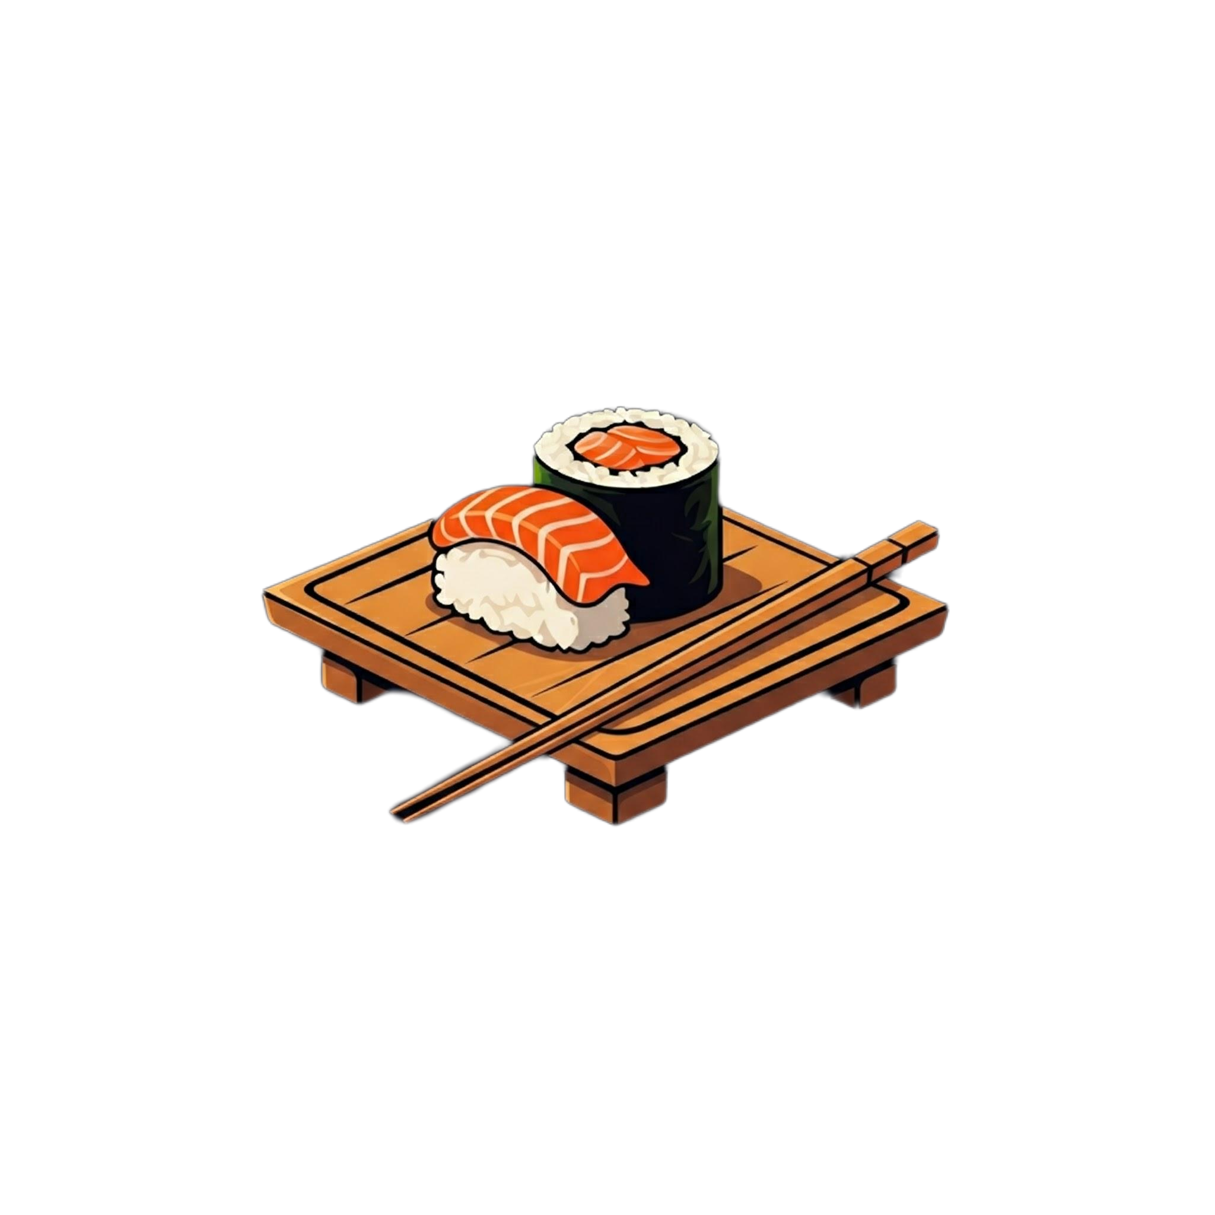

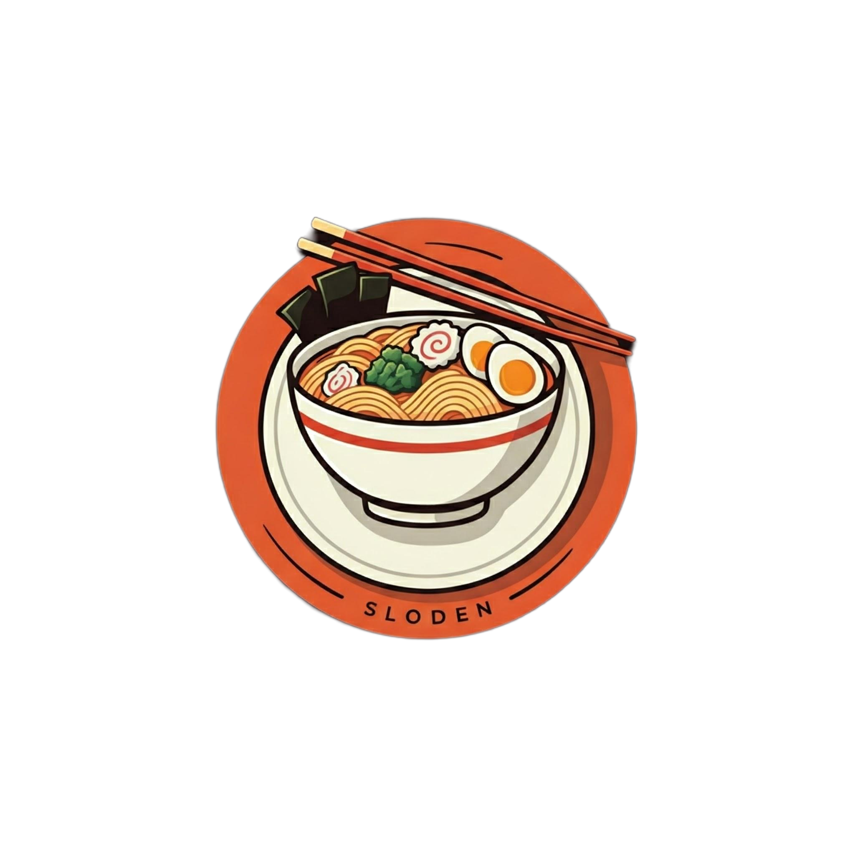
Product Names
1
2
3
Sushi
Curry
Ramen

Slide 6
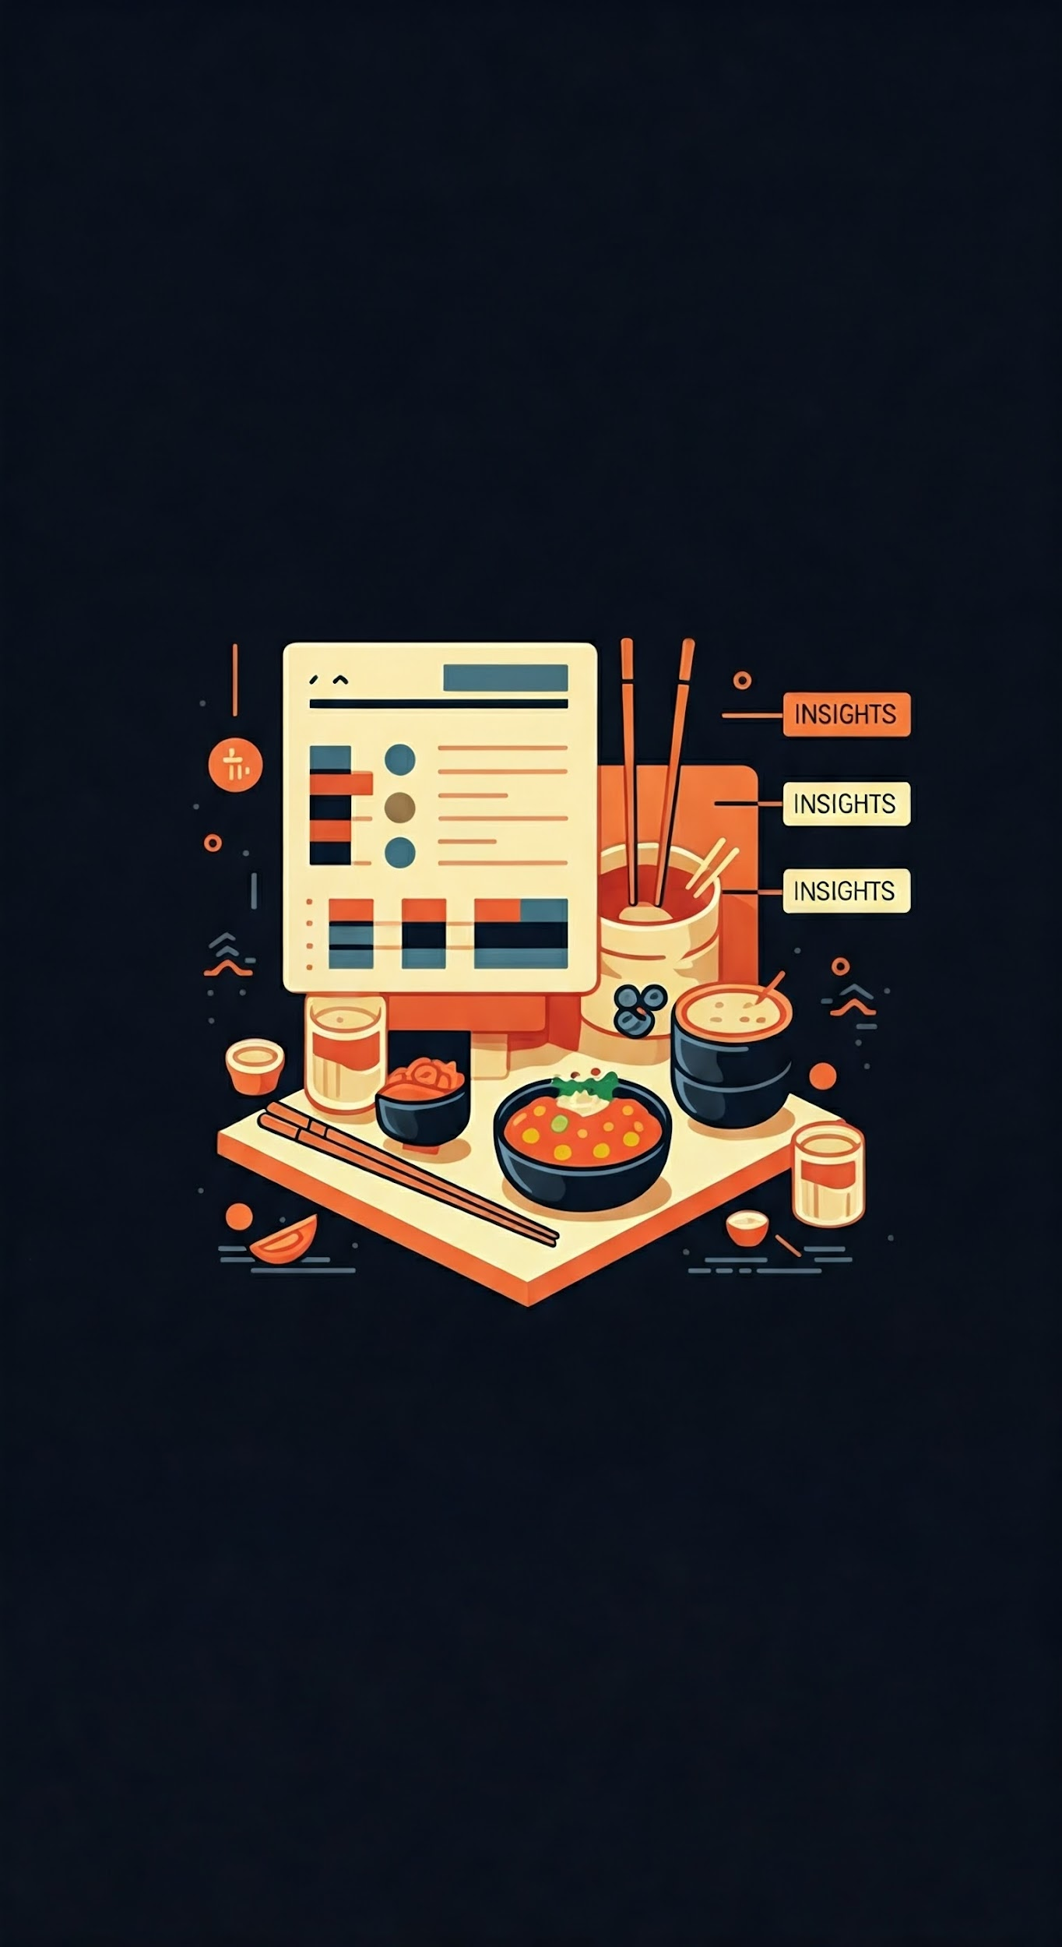
Insights
The insights are presented in the form of tables, and visualisations. There are total 10 questions that are answered.

Slide 7
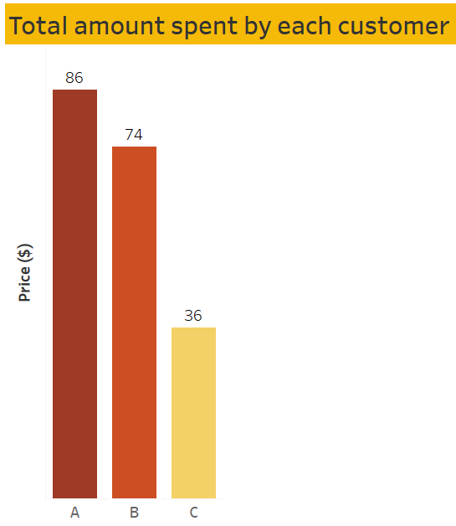
Customer A outspent all other customers, with a maximum expenditure of $86
1

Slide 8
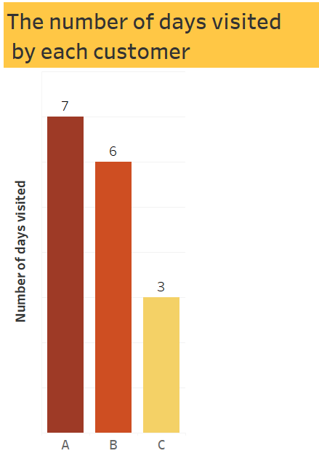
Customer A visited the most, with 7 visits. Customer B came in second, while Customer C visited the least.
2

Slide 9
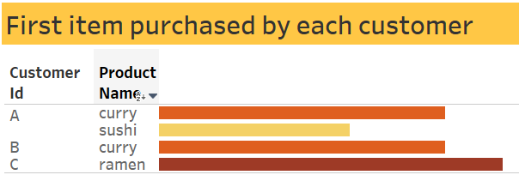
3
Customer A first bought curry and sushi, Customer B only bought curry, and Customer C bought ramen. Interestingly, Customer C spent the most money on just one dish.

Slide 10
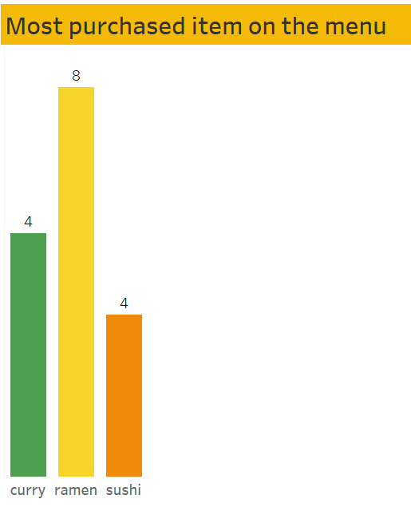
Ramen is the most popular item, ordered 8 times. Curry comes in second, while sushi is the least ordered. 🍜🍛🍣
4

Slide 11
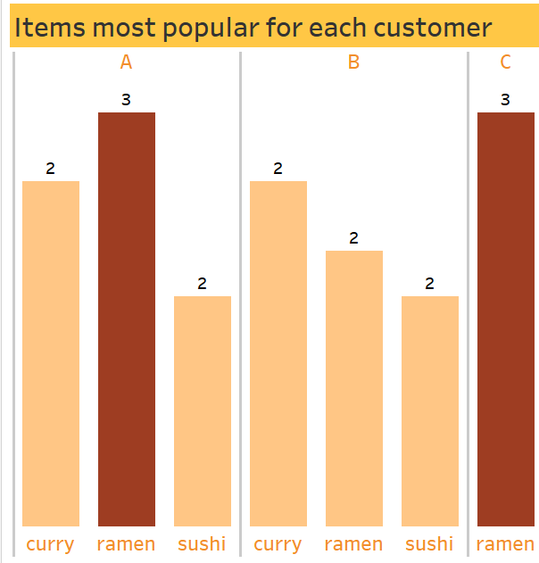
Customer A loves ramen the most, Customer B prefers curry, and Customer C has only ordered ramen once. 🍜🍛
5

Slide 12
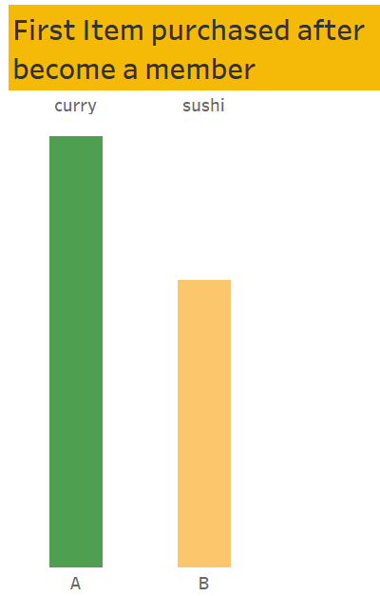
Since becoming a member, Customer A has ordered curry, and Customer B has ordered sushi. 🍛🍣
6

Slide 13
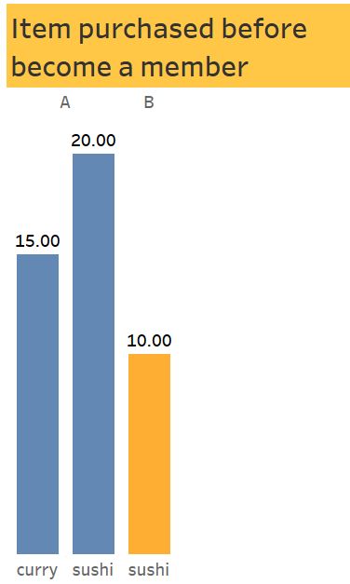
Before becoming members, Customer A's last purchase was sushi & curry , while Customer B's last purchase was sushi. 🍣🍛
7

Slide 14
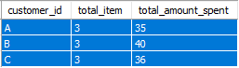
# 8 What is the total items and amount spent for each member before they become a member?
Before becoming a member, Customer B spent the most, with a total of $40. In comparison, Customer A spent $35 and Customer C spent $36. 💸

Slide 15
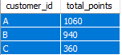
#9. If each $1 spent equates to 10 points and sushi has x2 points multiplier - how many points would each customer have?
Customer A has earned a total of 1060 points, indicating they made the highest number of purchases. Customer B follows with 940 points, and Customer C has 360 points, showing they made the least purchases. 🏆📈

Slide 16
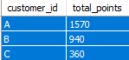
#10. In the first week after a customer joins the program (including their join date) they earn 2x points on all items, not just sushi — how many points do customer A and B have at the end of January?
Since becoming members, Customer A still leads with 1570 points. Customer B remains at 940 points, and Customer C stays at 360 points. 🏆📊

Slide 17
Summary of Insights
Top Spender: Customer A has spent the most, with a maximum expenditure of $86.
Visits: Customer A visited the most, with 7 visits, followed by Customer B. Customer C visited the least.
First Purchases: Customer A first bought curry and sushi, Customer B only bought curry, and Customer C bought ramen. Interestingly, Customer C spent the most on just one dish.
Popular Items: Ramen is the most purchased item, ordered 8 times. Curry is the second most popular, and sushi is the least ordered.
Customer Preferences: Customer A loves ramen the most, Customer B prefers curry, and Customer C has only ordered ramen once.
Membership Impact: After becoming a member, Customer A has ordered curry, and Customer B has ordered sushi. Customer A still has the highest points (1570), followed by Customer B (940) and Customer C (360).
Spending Before Membership: Before becoming a member, Customer B spent the most ($40), followed by Customer C ($36) and Customer A ($35).
Points Earned: Customer A has earned 1060 points, showing the highest number of purchases, while Customer B has 940 points, and Customer C has 360 points.
Customer A's significant impact on your business, with the highest expenditure, visits, and points. Ramen is the most popular menu item, and the introduction of memberships has influenced customer purchasing behavior. 🍜🍛📈

Slide 18
Recommendation
Enhance Loyalty Programs: Offer exclusive rewards and promotions to encourage repeat visits.
Promote Popular Items:Highlight and promote top-selling dishes like ramen.
Diversify Menu: Introduce new sushi varieties or offer promotional deals to boost sales.
Personalized Marketing: Target marketing efforts based on customer preferences.
Improve Membership Benefits: Offer exclusive perks to make memberships more appealing.
Engage Customers: Organize events and activities to build community.
Gather Feedback: Continuously seek customer feedback to improve service.
Strengthen Online Presence: Use social media and online reviews to attract new customers.
Optimize Pricing: Offer combo meals or value deals to attract budget-conscious customers.
Expand Reach: Explore delivery services or new branch locations to increase visibility.

